Slide 1
Lab Exercise

Slide 2

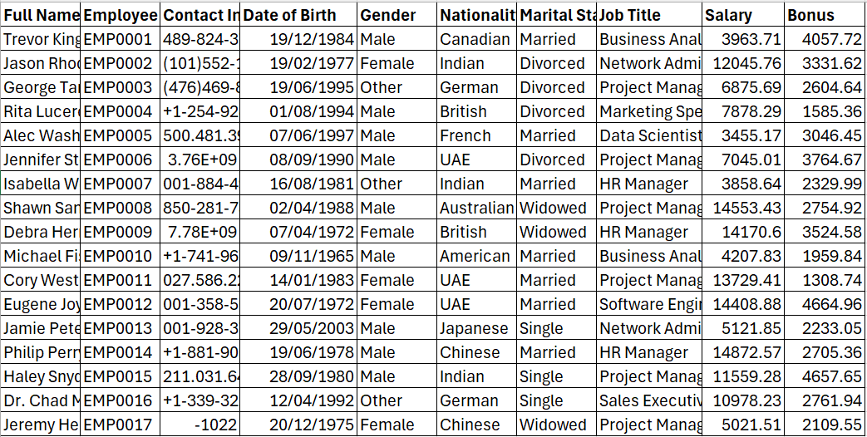
Dataset

Slide 3
Tasks
1. Identify various attributes / features of this dataset
2. Identify type of the features
3. Perform the followings
i. One hot encoding of Gender
Ii. Ordinal encoding of Job title
4. Perform the normalization of Salary and Bonus using Standardization
5. Perform Train, Validation, Test splitting of this dataset and print

